Slide 1
A 100nm Double-Stacked 500MHz 72Mb SRAM
Manny Xu CKT
20180502

Slide 2
Agenda
Background
Stacked SRAM
Automatic cell-bias
Adaptive block redundancy
Wordline pulse-width regulation

Slide 3
背景
Multi-core processors become mainstream ---->
Need for high-density cache memories
6T-cell based SRAMs limited to density---->
New double stacked S3 (stacked single-crystal Si) SRAM cell
And three schemes are introduced

Slide 4
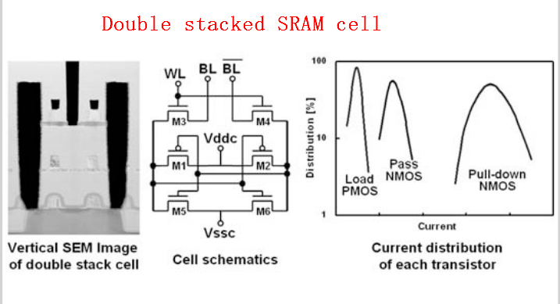
stacked S3 SRAM

Slide 5
stacked S3 SRAM
M1 to M4 are SOI transistors
it is difficult to control their characteristics compared with a bulk-based pulldown NMOS
Automatic cell-bias (ACB) scheme controls voltages to regulate the performance of those transistors
Notes:
SOI 绝缘层上的很薄的一层硅上面做器件,没有衬底的概念，有别于常见的衬底工艺

Slide 6
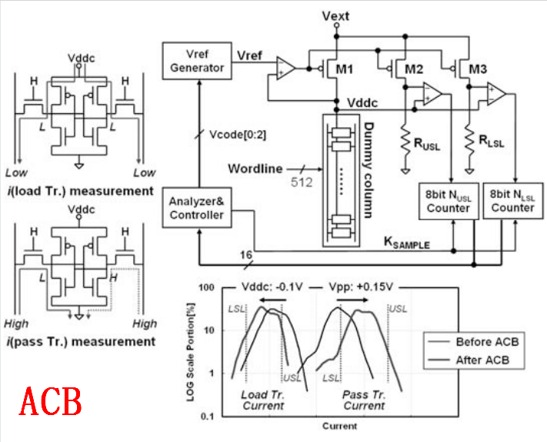
Automatic cell-bias

Slide 7
Automatic cell-bias
ACB controls the voltage level of cell power (Vddc) and wordline enable (Vpp) automatically at initial settling time
lowering Vddc → lower poewr
raising V_{wwl} → increase cell on current –> high-speed

Slide 8
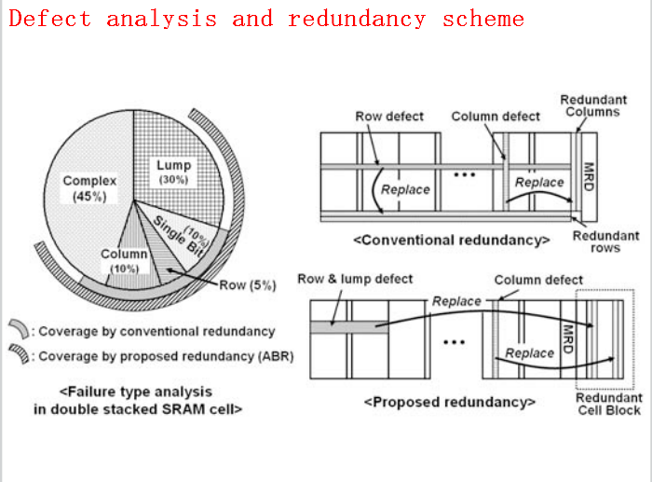
adaptive block redundancy

Slide 9
adaptive block redundancy
Stacked sram defects is relatively high, as much as 30%
ABR adds a redundant block to a group of blocks that share same I/Os

Slide 10
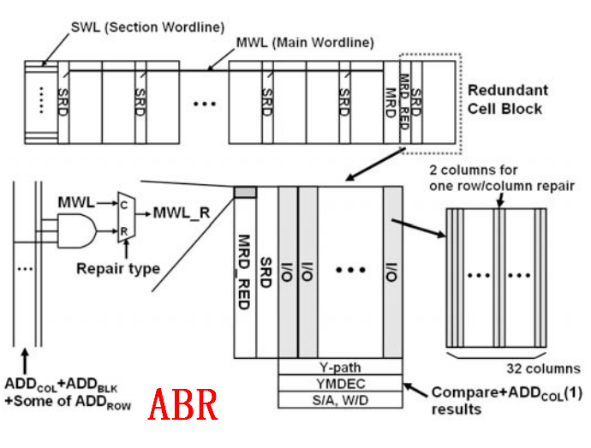
adaptive block redundancy

Slide 11
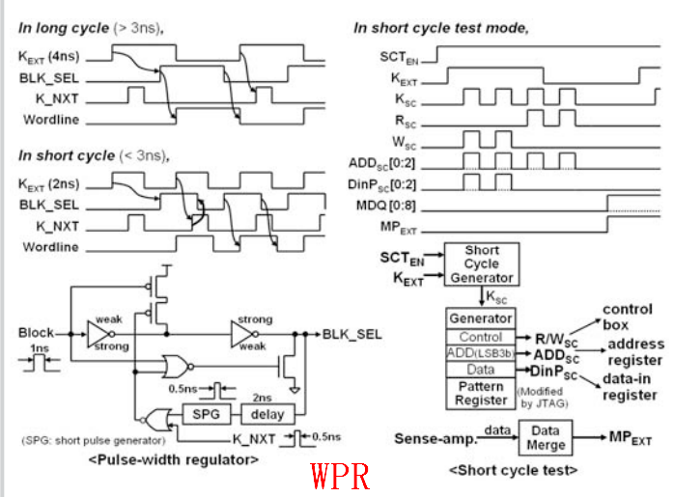
Wordline pulse-width regulation

Slide 12
Wordline pulse-width regulation
The pulse-width of the wordline is one of critical factors that determines the shortest cycle time

Slide 13
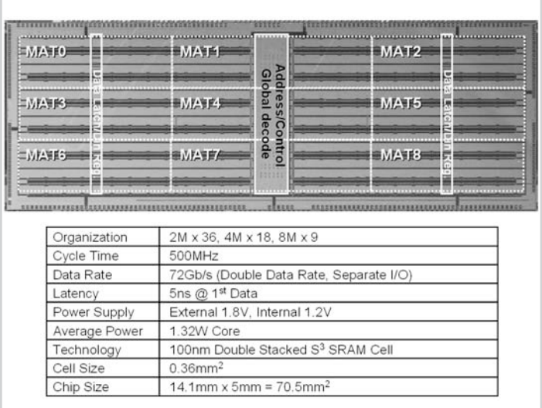
summary

Slide 14
Thank you

